Slide 1

Cyber Intrusion Detection
Predict and Categorize Modern Network Vulnerabilities

Slide 2

Problem Statement
Bridging the Detection Gap
Traditional firewalls struggle to isolate erratic, low-footprint intrusions hidden within massive traffic volumes.
Success Metrics:
Achieve a F1-Score > 90% to mitigate dense class skews.
Maintain a low False Alarm Rate to prevent operational fatigue in security teams.

Slide 3
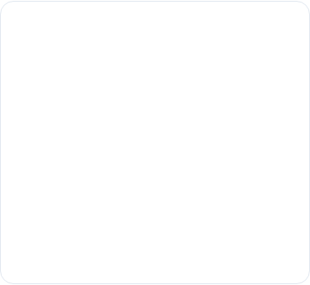
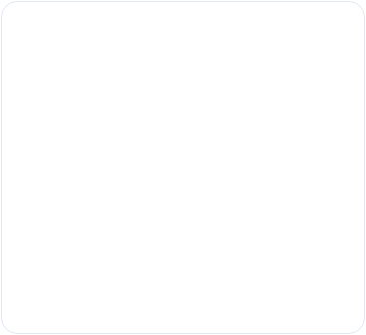
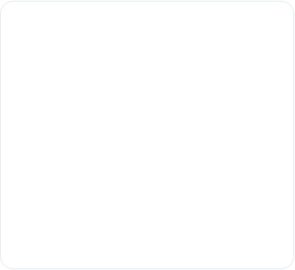






Target Audience
SOC Teams
Architects
Leadership
Operational engineers requiring real-time alert triage and anomaly filtering.
Systems designers focusing on performance and protocol security signatures.
IT Executives managing risk thresholds and compliance standards.

Slide 4
Modeling Goals & Objectives
2
Phased Modeling Strategy
We resolve two distinct challenges using a unified ML pipeline:
Model 1: Binary Classification to identify malicious vs. normal traffic. (63% Malicious, 37% Normal)
Model 2: Multi-class Classification to categorize attacks into 9 distinct categories.
Classification Models

Slide 5





Evaluation Metrics
F1-Score
Confusion Matrix
Standard accuracy is misleading to handle minority attack types.
Focusing on reducing False Negatives to prevent network breaches and False Positives to save man-hours.

Slide 6
About the Data: Feature Dictionary
Category | Key Metrics | Modeling Role
Header Basic | dur, sbytes, sttl, rate | Foundational traffic structure indicators.
Content Flow | sload, dload, smean | Packet payload and intensity analysis.
Time & Jitter | sjit, djit, tcprtt | Detecting automated timing signatures.

Slide 7


EDA Modeling Insights
Structural Anomalies
Predictive Patterns
Extreme right-skewness in rate and sbytes necessitates log-transformation to stabilize model training.
sttl shows predictive separation between normal and malicious traffic. And rate between multiclass categories.
Zero explicit nulls exist, but hidden "-" in service have been re-mapped to "Unspecified".

Slide 8






Progress & Next Steps
Current Challenges
Actions
Models
Managing the severe class imbalance in the "Worms" category (<0.1%).
Applying Log-Transformations and Cross Validation to ensure all categories are trained.
Applying Logistics Regression,
XGBOOST

